Slide 1
MVP in kotlin
PRESENTED BY:
MUHAMMAD HAMZA (17L-4135)
SHAHZAIB ALI (17L-4071)
FARHAN ALI (17L-4068)
SAJJAD ALI (17L-4179)

Slide 2
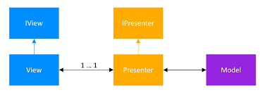
What is mvp
Model View Presenter
Architectural Pattern in ANDROID
TAKES OUT BUSINESS and PERSISTENCE LOGIC out of the VIEWS
Presenter is the MIDDLE-MAN
Presenter is Responsible for the Communication between Views and Models

Slide 3

WHY KOTLIN ?
Google is Backing it up
Compatible with JAVA
More concise than JAVA
Easy to Maintain
Less Boilerplate Code

Slide 4
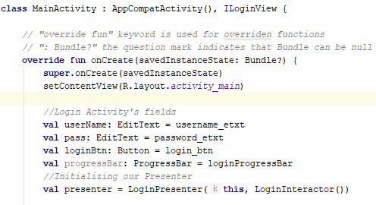
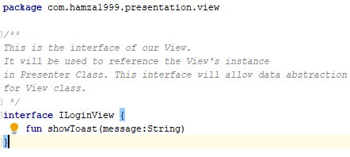
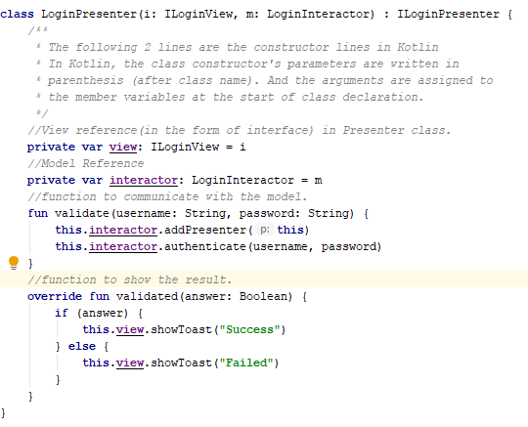
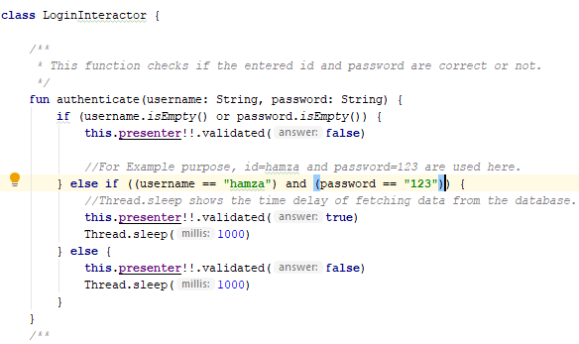
MVP – Design Pattern

Slide 5
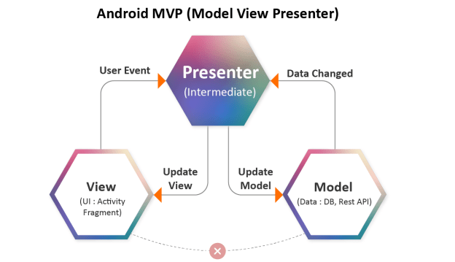
Advantages of mvp
Separation of Responsibilities
Data Abstraction
Modularity
Unit Testing is Easy
Code Reusability

Slide 6
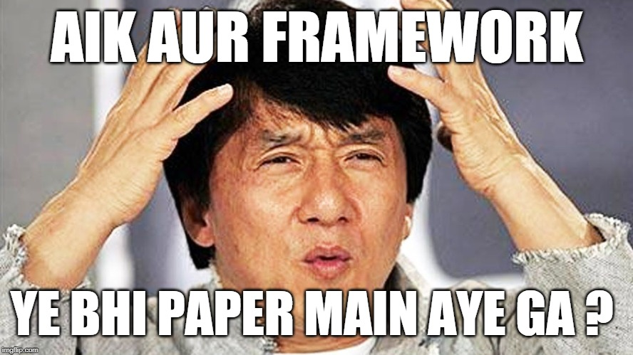
disadvantages of mvp
High Level Coupling
Higher complexity
Extra learning curve
Not suitable for simple and small solutions

Slide 7
Moving on to the code…
https://github.com/megahertz1999/presentation

Slide 8
